Slide 1


SNS COLLEGE OF TECHNOLOGY An Autonomous Institution Coimbatore-35. Accredited by NBA – AICTE and Accredited by NAAC – UGC with ‘A+’ Grade Approved by AICTE, New Delhi & Affiliated to Anna University, Chennai
Final Review
Car Damage Detector Using Web and Mobile Based Application
BATCH NO - 7
Guided by
Mrs.M.Lavanya AP/CSE,
Dept of computer science Engg,
SNS College of Technology.
Presented by
Dinesh T 19CS029
Harikrishnan M 19CS036
Arvind J 19CS503
Ashok N 19CS506

Slide 2
ABSTRACT
Car damage detection using machine learning is an emerging area that is gaining popularity due to its ability to quickly and accurately identify any damage to a car.
This technology consists of two main components: the hardware, which captures images or videos of the car, and the software, which analyzes these images or videos to identify any damage.
The hardware component of a car damage detector can take many different forms, such as a camera mounted on a tripod, a drone, or a mobile phone or tablet. In some cases, multiple cameras are required to capture images of the car from different angles.
The software component of the car damage detector is responsible for analyzing the images or videos to identify any damage, which is typically done using computer vision techniques and machine learning algorithms.
There are many different types of damage that can occur to a car, and each type may require a different approach to detection. For example, detecting dents and scratches may require a different algorithm than detecting cracks in the windshield or damage to the frame of the car.

Slide 3
INTRODUCTION
Car damage detection has become an important area of research in recent years. Accidents can cause significant damage to vehicles, and it can be difficult to identify all of the damage, especially if it is hidden or not immediately apparent. This is where a car damage detector comes in handy.
By using web and mobile-based technology, it is possible to quickly and accurately identify any damage to a car, which can help to speed up the repair process and ensure that the car is safe to drive.
A car damage detector using web and mobile technology typically consists of two main components: the hardware and the software.
The hardware component is responsible for capturing images or videos of the car, while the software component is responsible for analyzing these images or videos to identify any damage.

Slide 4
PROBLEM STATEMENT
Car damages can be expensive and time-consuming to identify and repair. Currently, car owners often have to rely on a visual inspection to identify any damages, which can be difficult and inaccurate.
Additionally, it can be challenging to determine the extent of the damage and whether it is severe enough to warrant a repair.
This can lead to further deterioration of the car and higher repair costs.
Moreover, the insurance claim process can be lengthy and complicated, with inaccurate damage reports causing delays and potential disputes.
Therefore, there is a need for an accurate and efficient car damage detector system that can simplify the process of identifying damages and streamline the insurance claim process.

Slide 5
EXISTING SYSTEM
There are currently a few car damage detection solutions available on the market, such as car inspection apps, but they typically require a professional inspector to assess the damages.
Some insurance companies also provide their own mobile apps to simplify the claim process, but these apps often require manual input of the damage information.
Additionally, some car manufacturers have integrated damage detection systems into their vehicles, but these systems can be expensive and limited to specific models.
Overall, there is a lack of accurate and user-friendly car damage detection solutions available to the general public. Therefore, there is a need for a reliable and accessible car damage detector system that can be used by anyone.

Slide 6
PROPOSED SYSTEM
The proposed car damage detector system is a mobile-based application that utilizes machine learning algorithms to identify different types of damages in a car.
Users can take pictures of their car using their smartphone or web camera and upload them to the system, which will then analyze the images to detect any damages.
The application will generate a report highlighting the type and severity of the damage, allowing users to make informed decisions about repairs.
The system will also store the images and reports for future reference.
The proposed system aims to provide an accurate, user-friendly, and accessible solution to simplify the process of detecting car damages and detecting the cost estimation of the specified damaged part.

Slide 7
COMPONENTS
The car damage detector using a web and mobile-based application consists of several components that work together to identify and assess damage. These components include:
Cameras: The car damage detector requires cameras to capture images of the car. These cameras can be installed in various locations on the car, such as the front, back, and sides.
Machine learning algorithm: The images captured by the cameras are processed by a machine learning algorithm that can identify and classify different types of damage, such as dents, scratches, and cracks.
Cloud storage: The images captured by the cameras are stored in the cloud, which allows for easy access by the user.
Web and mobile-based application: The user interface of the car damage detector is a web and mobile-based application. The application allows the user to access the images of the car and the assessment of the damage.

Slide 8
BENEFITS
There are several benefits to using a car damage detector using a web and mobile-based application. These benefits include:
Accurate assessment: The machine learning algorithm used by the car damage detector can provide an accurate assessment of the damage, which can aid in determining the cost and time required for repairs.
Cost-effective: The car damage detector can help reduce the cost of repairs by identifying the extent of the damage and preventing overestimation of repair costs.
Time-efficient: The car damage detector can help save time by providing a quick assessment of the damage, which can help the mechanic start the repairs sooner.
Easy access: The web and mobile-based application allow for easy access to the assessment of the damage and the images of the car.
Remote assessment: The car damage detector can allow for remote assessment of the damage, which can be useful for or remote repairs.

Slide 9
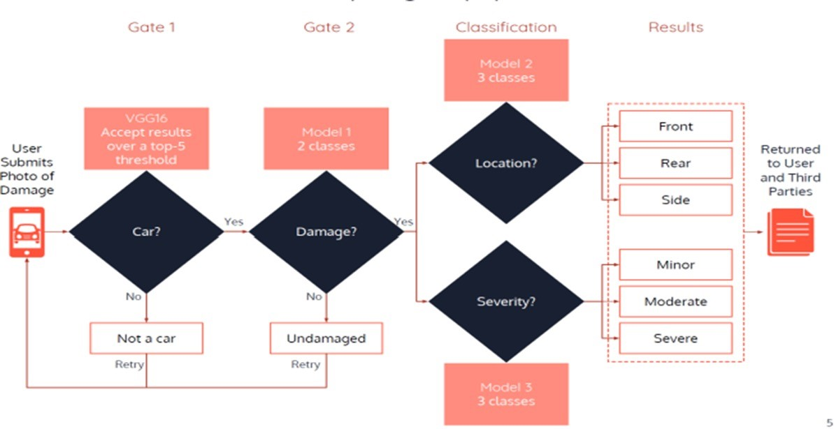
PROPOSED SYSTEM

Slide 10
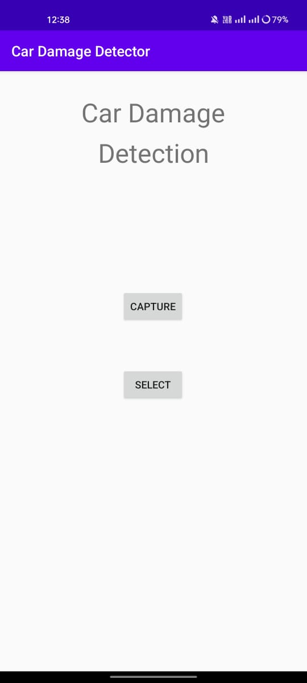
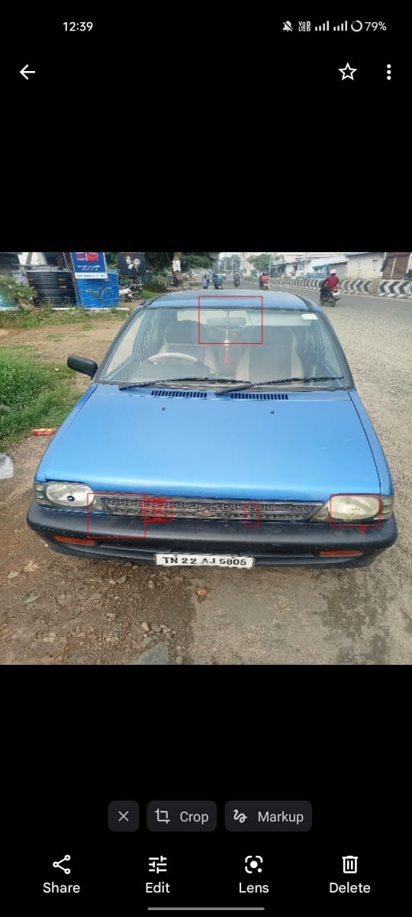
MOBILE APPLICATION

Slide 11
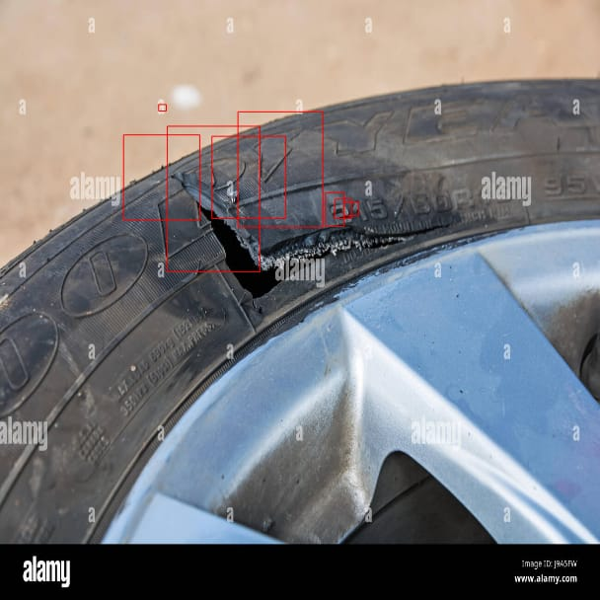
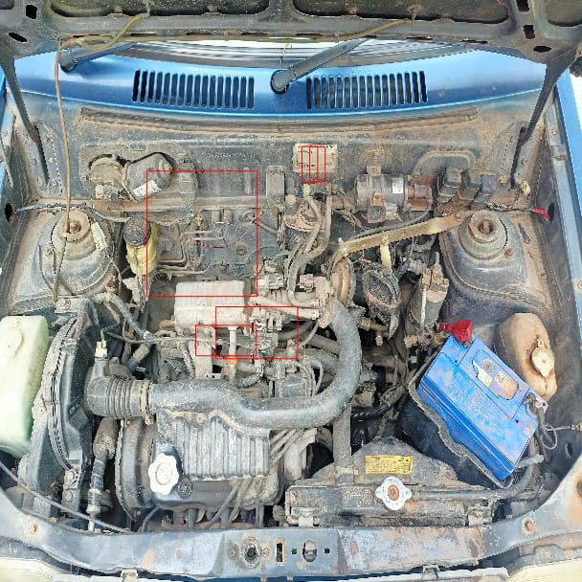
MOBILE APPLICATION

Slide 12
MOBILE APPLICATION

Slide 13
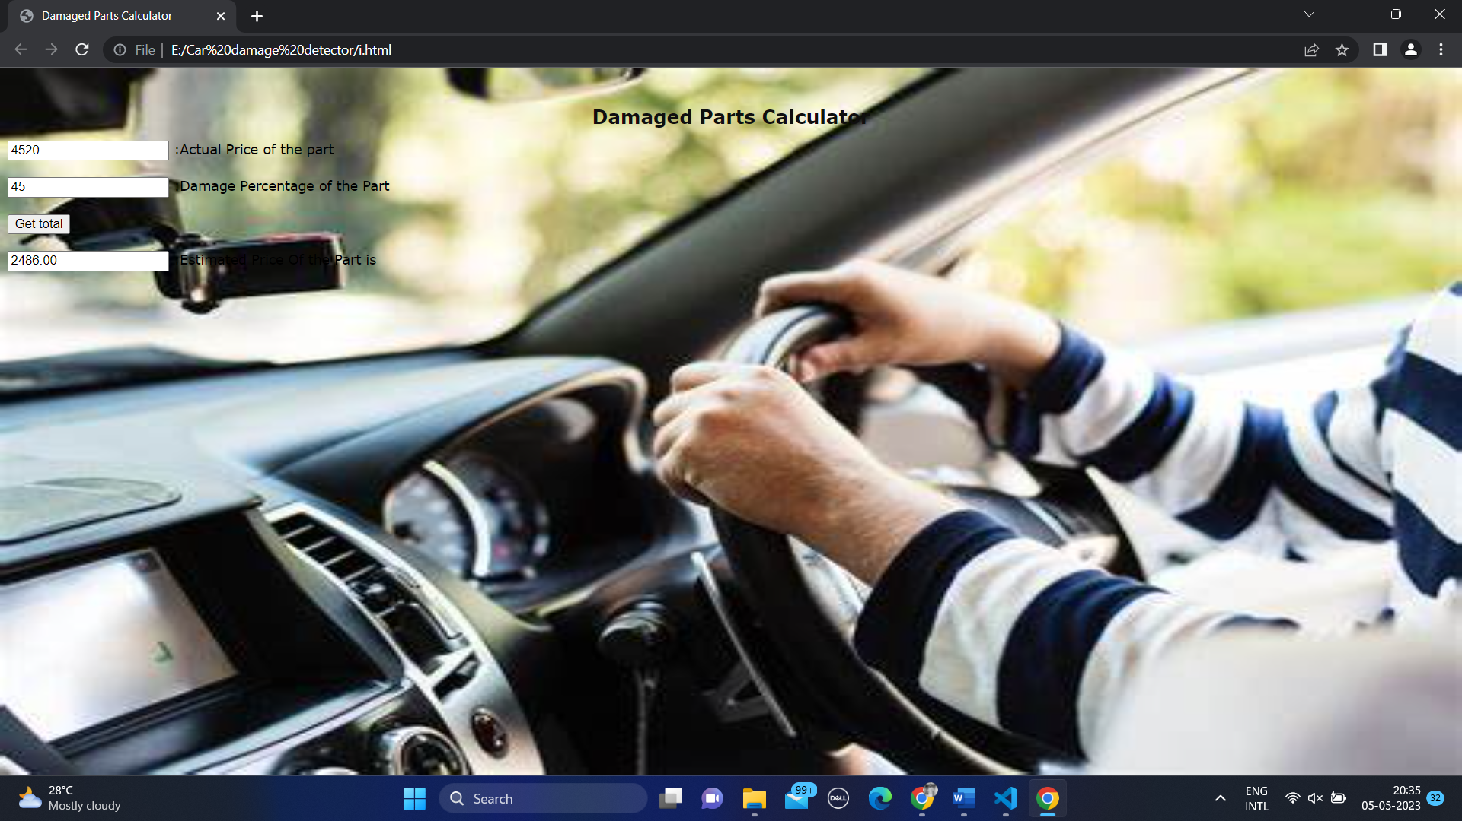
WEB APPLICATION

Slide 14
CONLCUSION
. In conclusion, a car damage detector using a web and mobile-based application can provide significant benefits for car owners and mechanics alike. With the ability to accurately identify and assess damage, this technology can save time and money, while also providing a more efficient repair process. The use of machine learning algorithms and cloud storage makes it possible to quickly and easily access information about car damage, enabling remote assessments.
Overall, a car damage detector using a web and mobile-based application is an innovative solution that can provide significant benefits for car owners and mechanics alike. With its ability to accurately identify and assess damage, save time and money, and provide easy access to information, it is likely to become an increasingly popular tool in the automotive industry. As machine learning and cloud technology continue to advance, the capabilities of car damage detectors are likely to improve, providing even greater benefits for car owners and mechanics in the future.

Slide 15
REFERENCES
Najmeddine Dhieb, Hakim Ghazzai, Hichem Besbes, and Yehia Massoud. 2019. Extreme Gradient Boosting MachineLearning Algorithm For Safe Auto Insurance Operations. In2019 IEEE International Conference of Vehicular Electronicsand Safety (ICVES). IEEE, 1–5.
Najmeddine Dhieb, Hakim Ghazzai, Hichem Besbes, and Yehia Massoud. 2019. A very deep transfer learning modelfor vehicle damage detection and localization. In2019 31st International Conference on Microelectronics (ICM). IEEE,158–161.
Jason Yosinski, Jeff Clune, Yoshua Bengio, and Hod Lipson. 2014. How transferable are features in deep neuralnetworks?. InAdvances in neural information processing systems. 3320–3328.
Mahavir Dwivedi, Malik Hashmat Shadab, SN Omkar, Edgar Bosco Monis, Bharat Khanna, and Satya Ranjan. [n.d.].Deep Learning Based Car Damage Classification and Detection. ([n. d.]
Kalpesh Patil, Mandar Kulkarni, Anand Sriraman, and Shirish Karande. 2017. Deep learning based car damageclassification. In2017 16th IEEE International Conference on Machine Learning and Applications (ICMLA). IEEE, 50–54.

Slide 16
THANK YOU

